Slide 1
Chatbot CantoMate
Group 4
Alexia Tsang, William Man, William Wat

Slide 2
TABLE OF CONTENTS
01
02
03
04
Emphasize
Ideate
Prototype
Feedback
Conducting interview with users
Constructing POV
Features in CantoMate App
Reflection

Slide 3

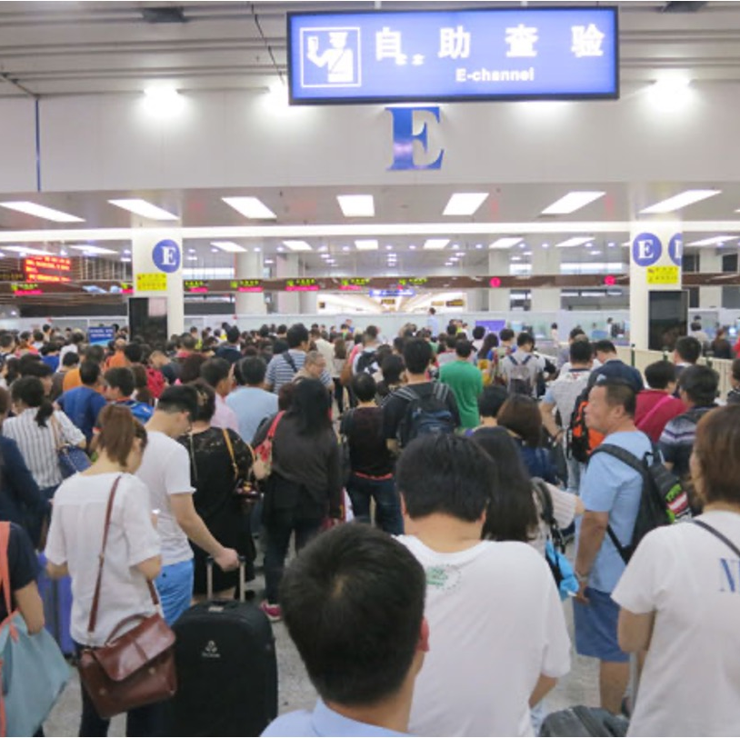

New Immigrants
Key user: new immigrants from Mainland China
Aged between 18 to 35
On average: 104 new immigrants everyday

Slide 4
01
Emphasize
Knowing more about users and Identify a scenario

Slide 5
Emphasize via research
>50%
Difficulties in Adaptation
H
>30%
Difficulties in Language
>10%
Difficulties in Living Habits

Slide 6

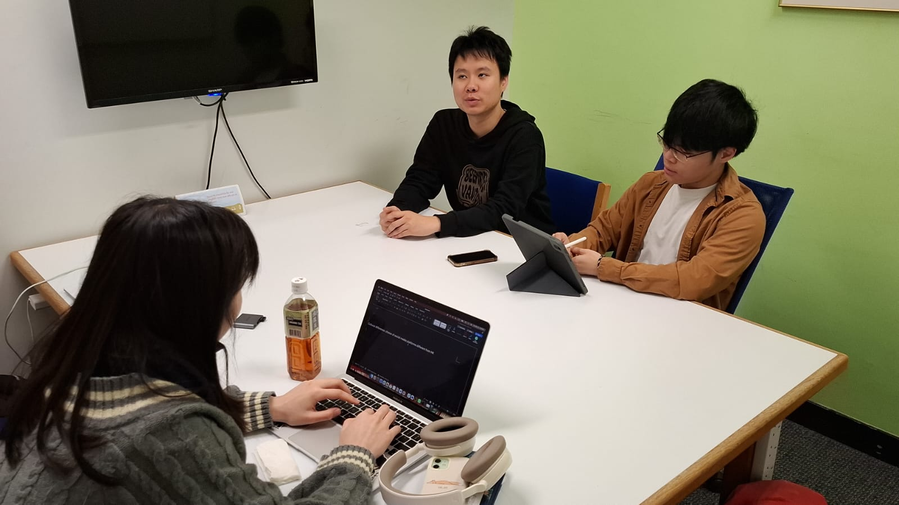
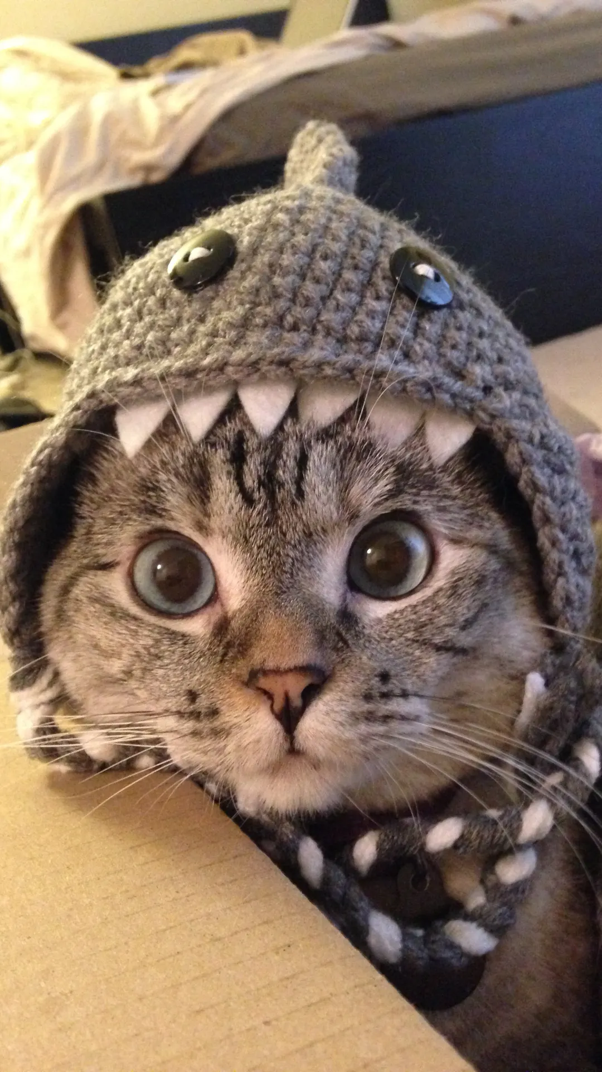
Emphasize through Interview
1.
2.
Language
Sound Media
Traditional Chinese, Not familiar with HK’s slang
While Local use IG or WhatsApp, Mainlanders use WeChat
3.
4.
Group Chats
Administration
Lower diversity of member as most of them are students
Complex Procedure to apply financial support

Slide 7
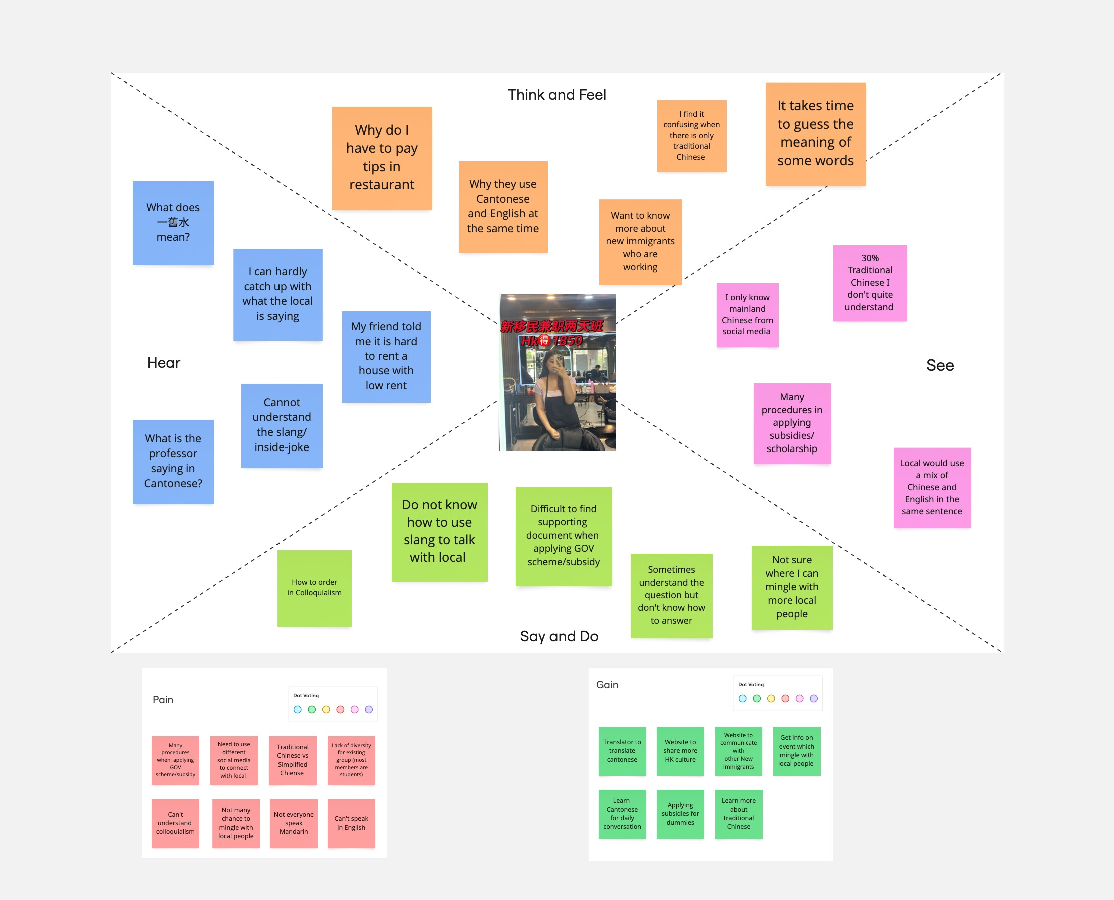
Empathy Map

Slide 8

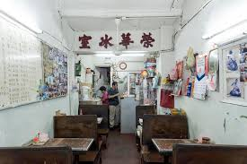
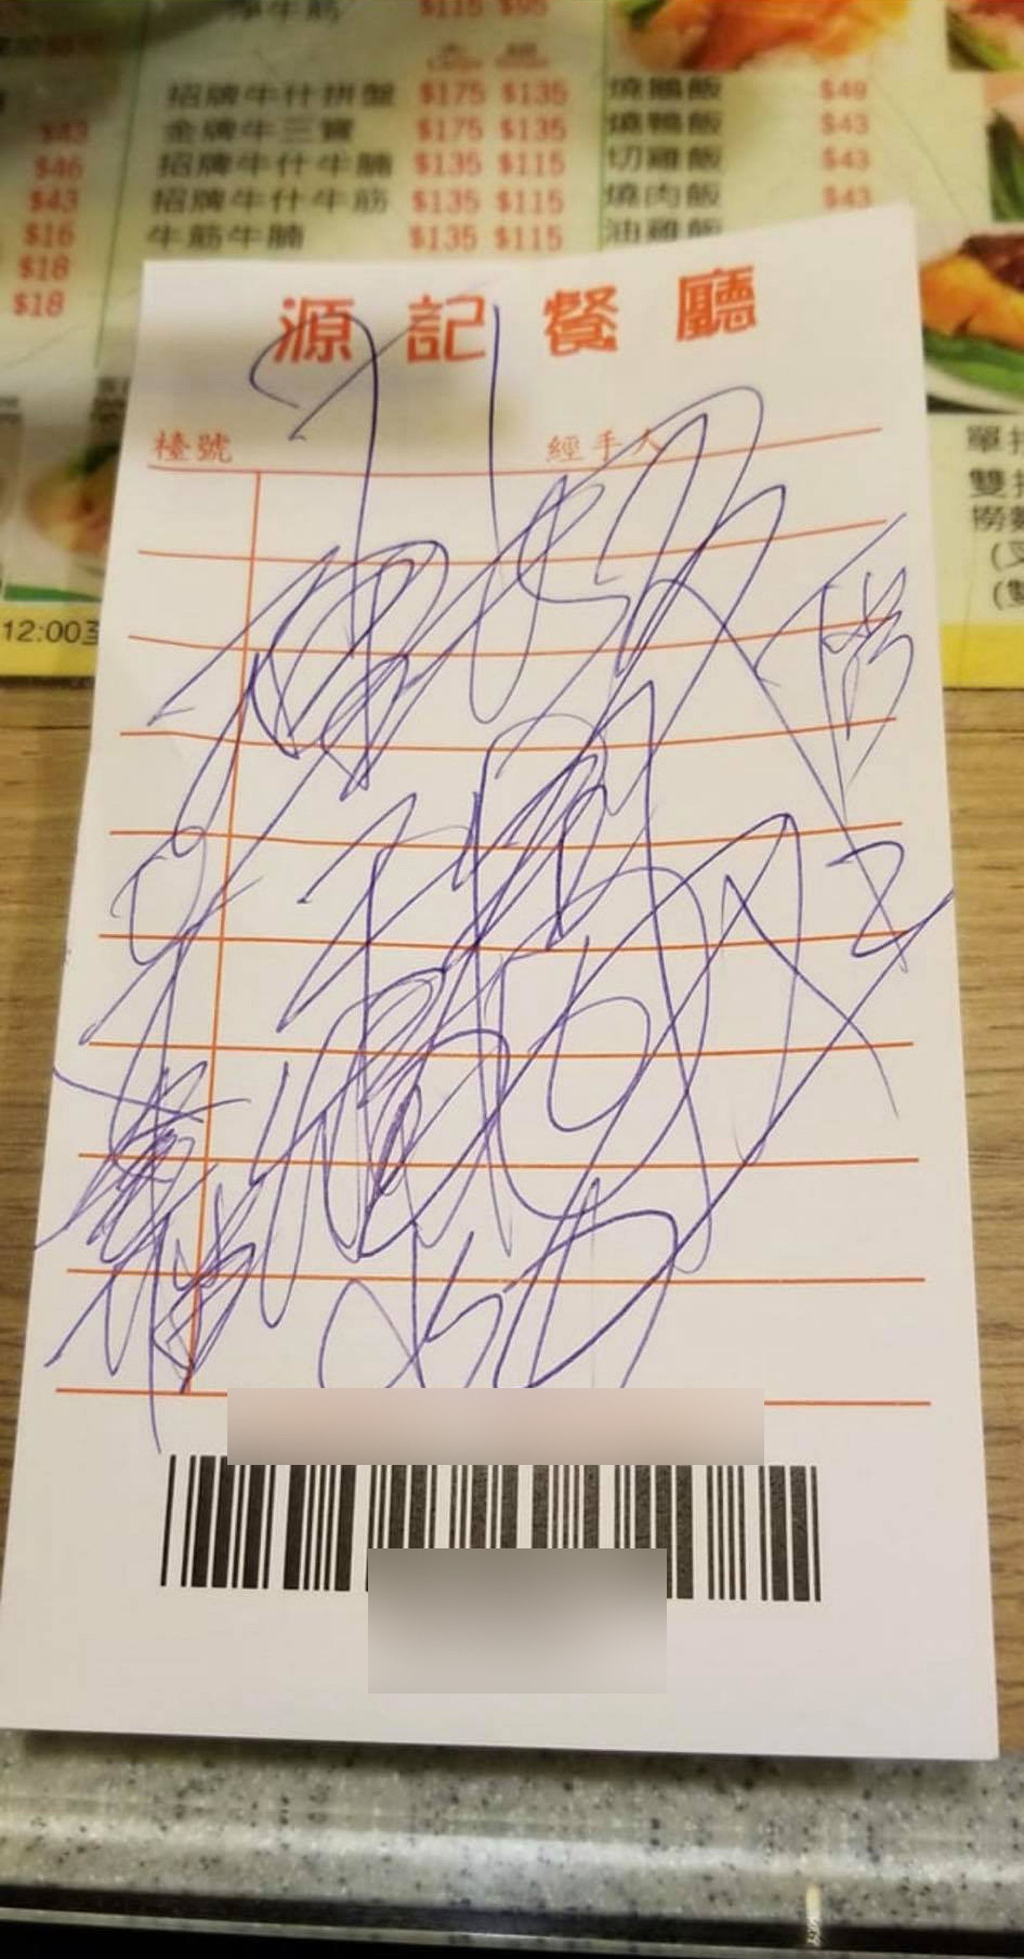
A Scenario
Arriving a local tea cafe
Want to order in Cantonese
Chatbot to learn simple Cantonese sentence for ordering
Notes:
Li Ming opens the chatbot on his phone and:
Input the Mandarin name of a dish. The chatbot provides the Cantonese pronunciation and a phonetic guide.
The chatbot translates menu items and suggests local specialties.
The chatbot generates a simple Cantonese sentence for ordering: "我要一碗云吞面 (ngóh yiu yāt wún wàhn tān mihn)."
Li Ming plays the audio output to the restaurant staff or practices saying it himself.
The chatbot provides cultural tips, explaining that customers should pay at the cashier rather than at the table.
5. Outcome
Li Ming successfully orders his meal.
He gains confidence in using Cantonese for daily interactions.
He feels more comfortable navigating life in Hong Kong

Slide 9
02
Ideate
Constructing POV & Storyboarding

Slide 10
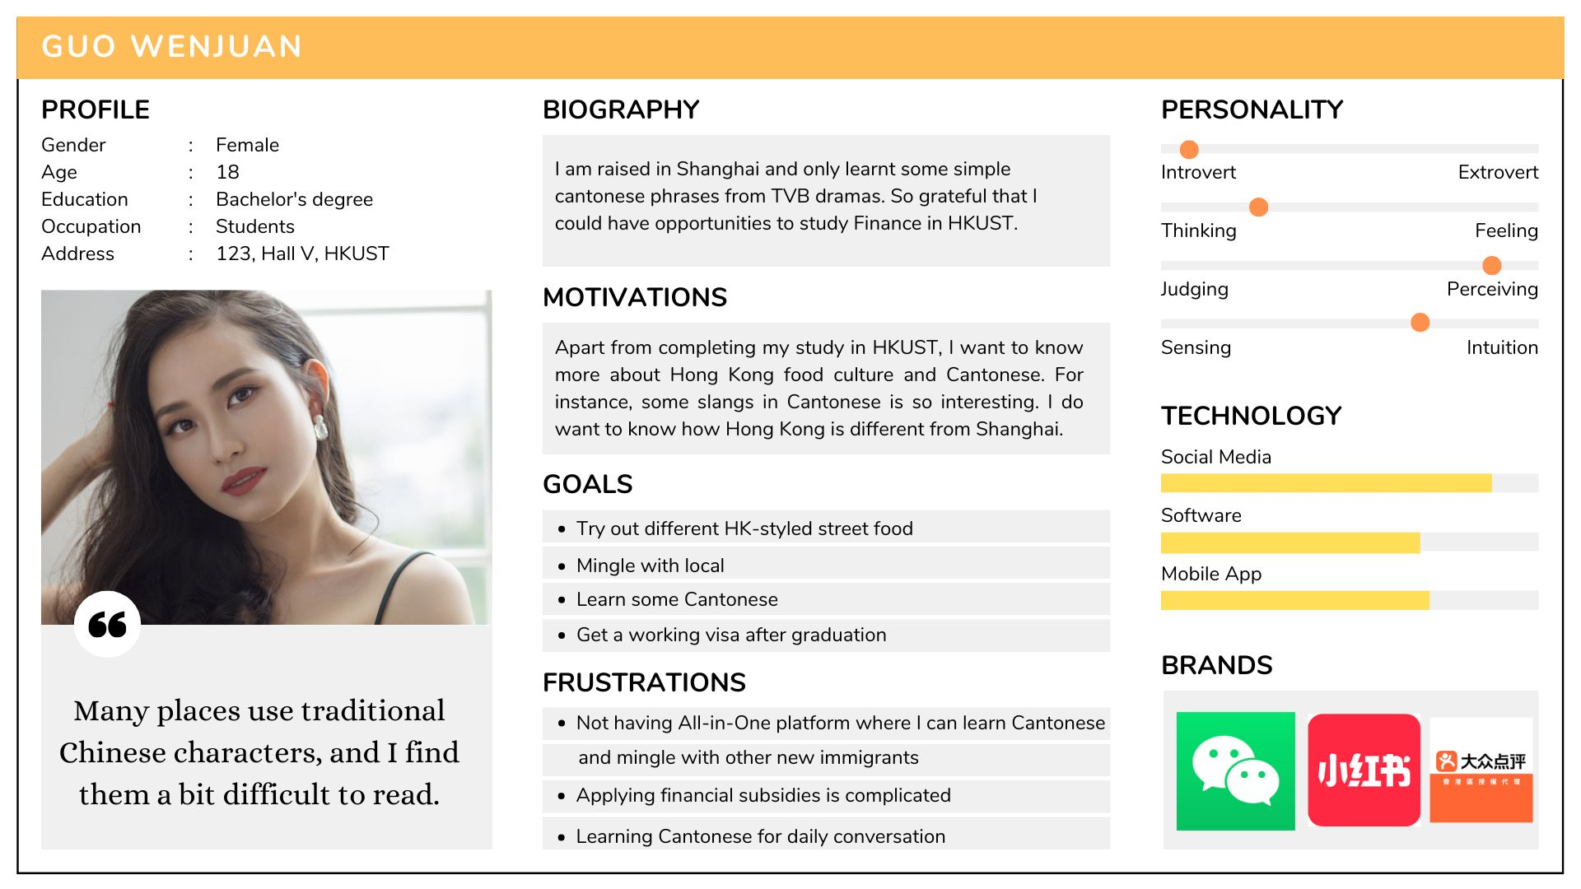
Persona
Notes:
Based on our research and interview, we created a Persona

Slide 11



POV
What do users need
to achieve their goals?

Slide 12
POV: user needs & insights
New immigrants need a Cantonese learning tool to learn
Cantonese for daily communication
New immigrants want a tool to raise questions about HK culture
New immigrants want a platform to connect with new immigrants from
different age range

Slide 13
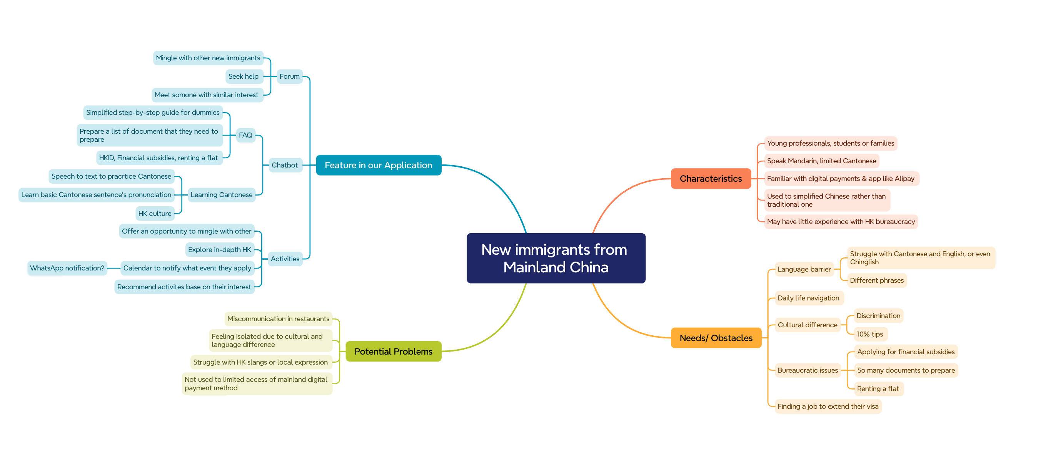
Brainstorming ideas

Slide 14
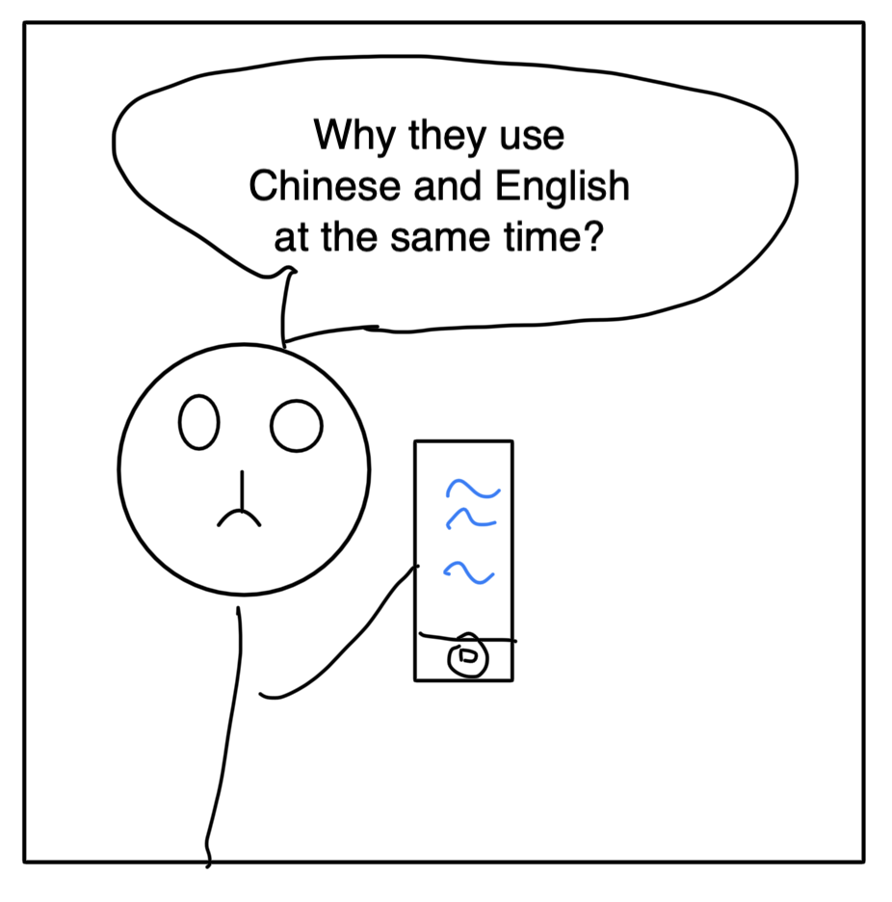
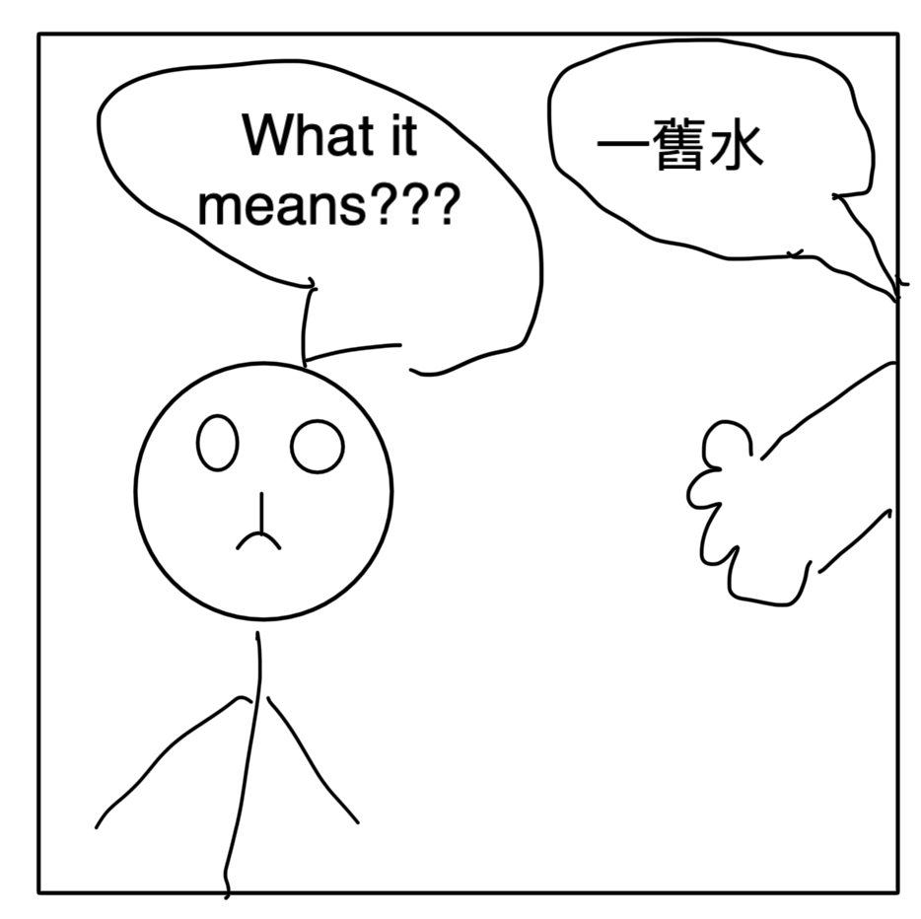
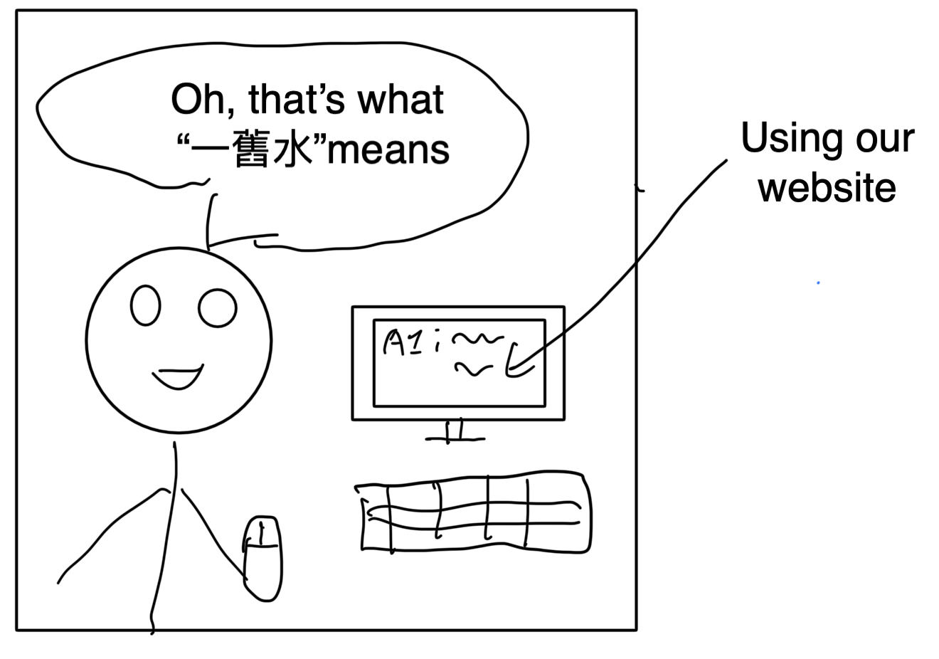
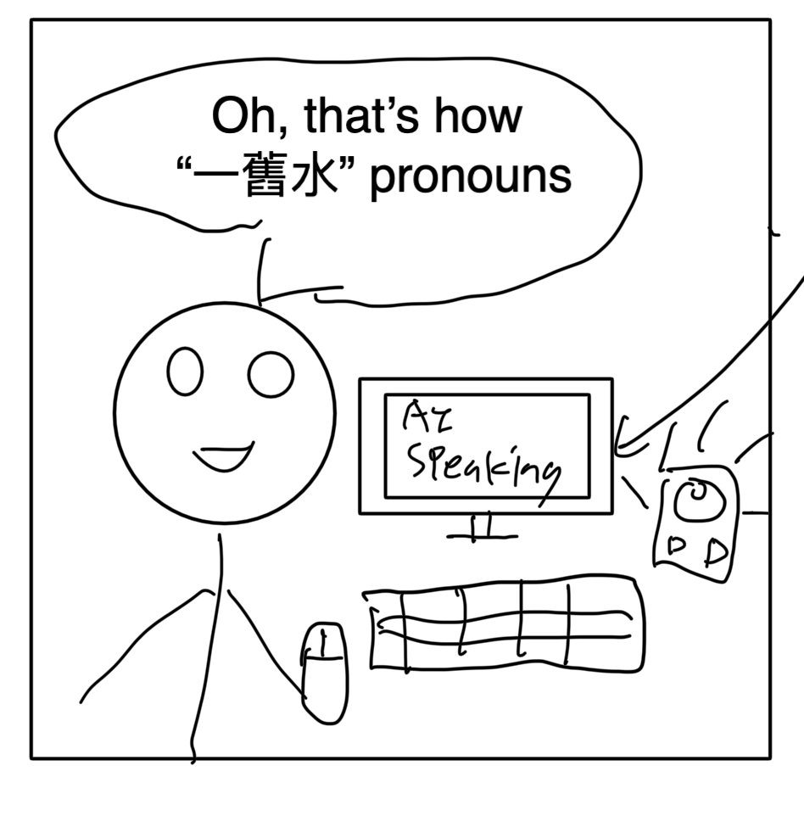
Storyboarding for verification
Facing Language difficulties in Cantonese
Learning Cantonese & HK Culture via our App

Slide 15
03
Prototype
Our Design Decision & Video demo

Slide 16



SOLUTION
CantoMate
A web application named which consist of chatbot, forum and activity pages so that new immigrants can learn Cantonese, Hong Kong culture and mingle with other new immigrants and locals

Slide 17
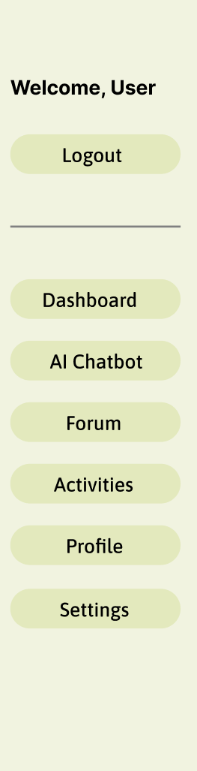
PRODUCT OVERVIEW
Chatbot
1
Forum
2
Activities
3
Ask me any questions about Hong Kong & Cantonese
Mingle with other new immigrants from different age range
Exploring Hong Kong with
New Friends

Slide 18
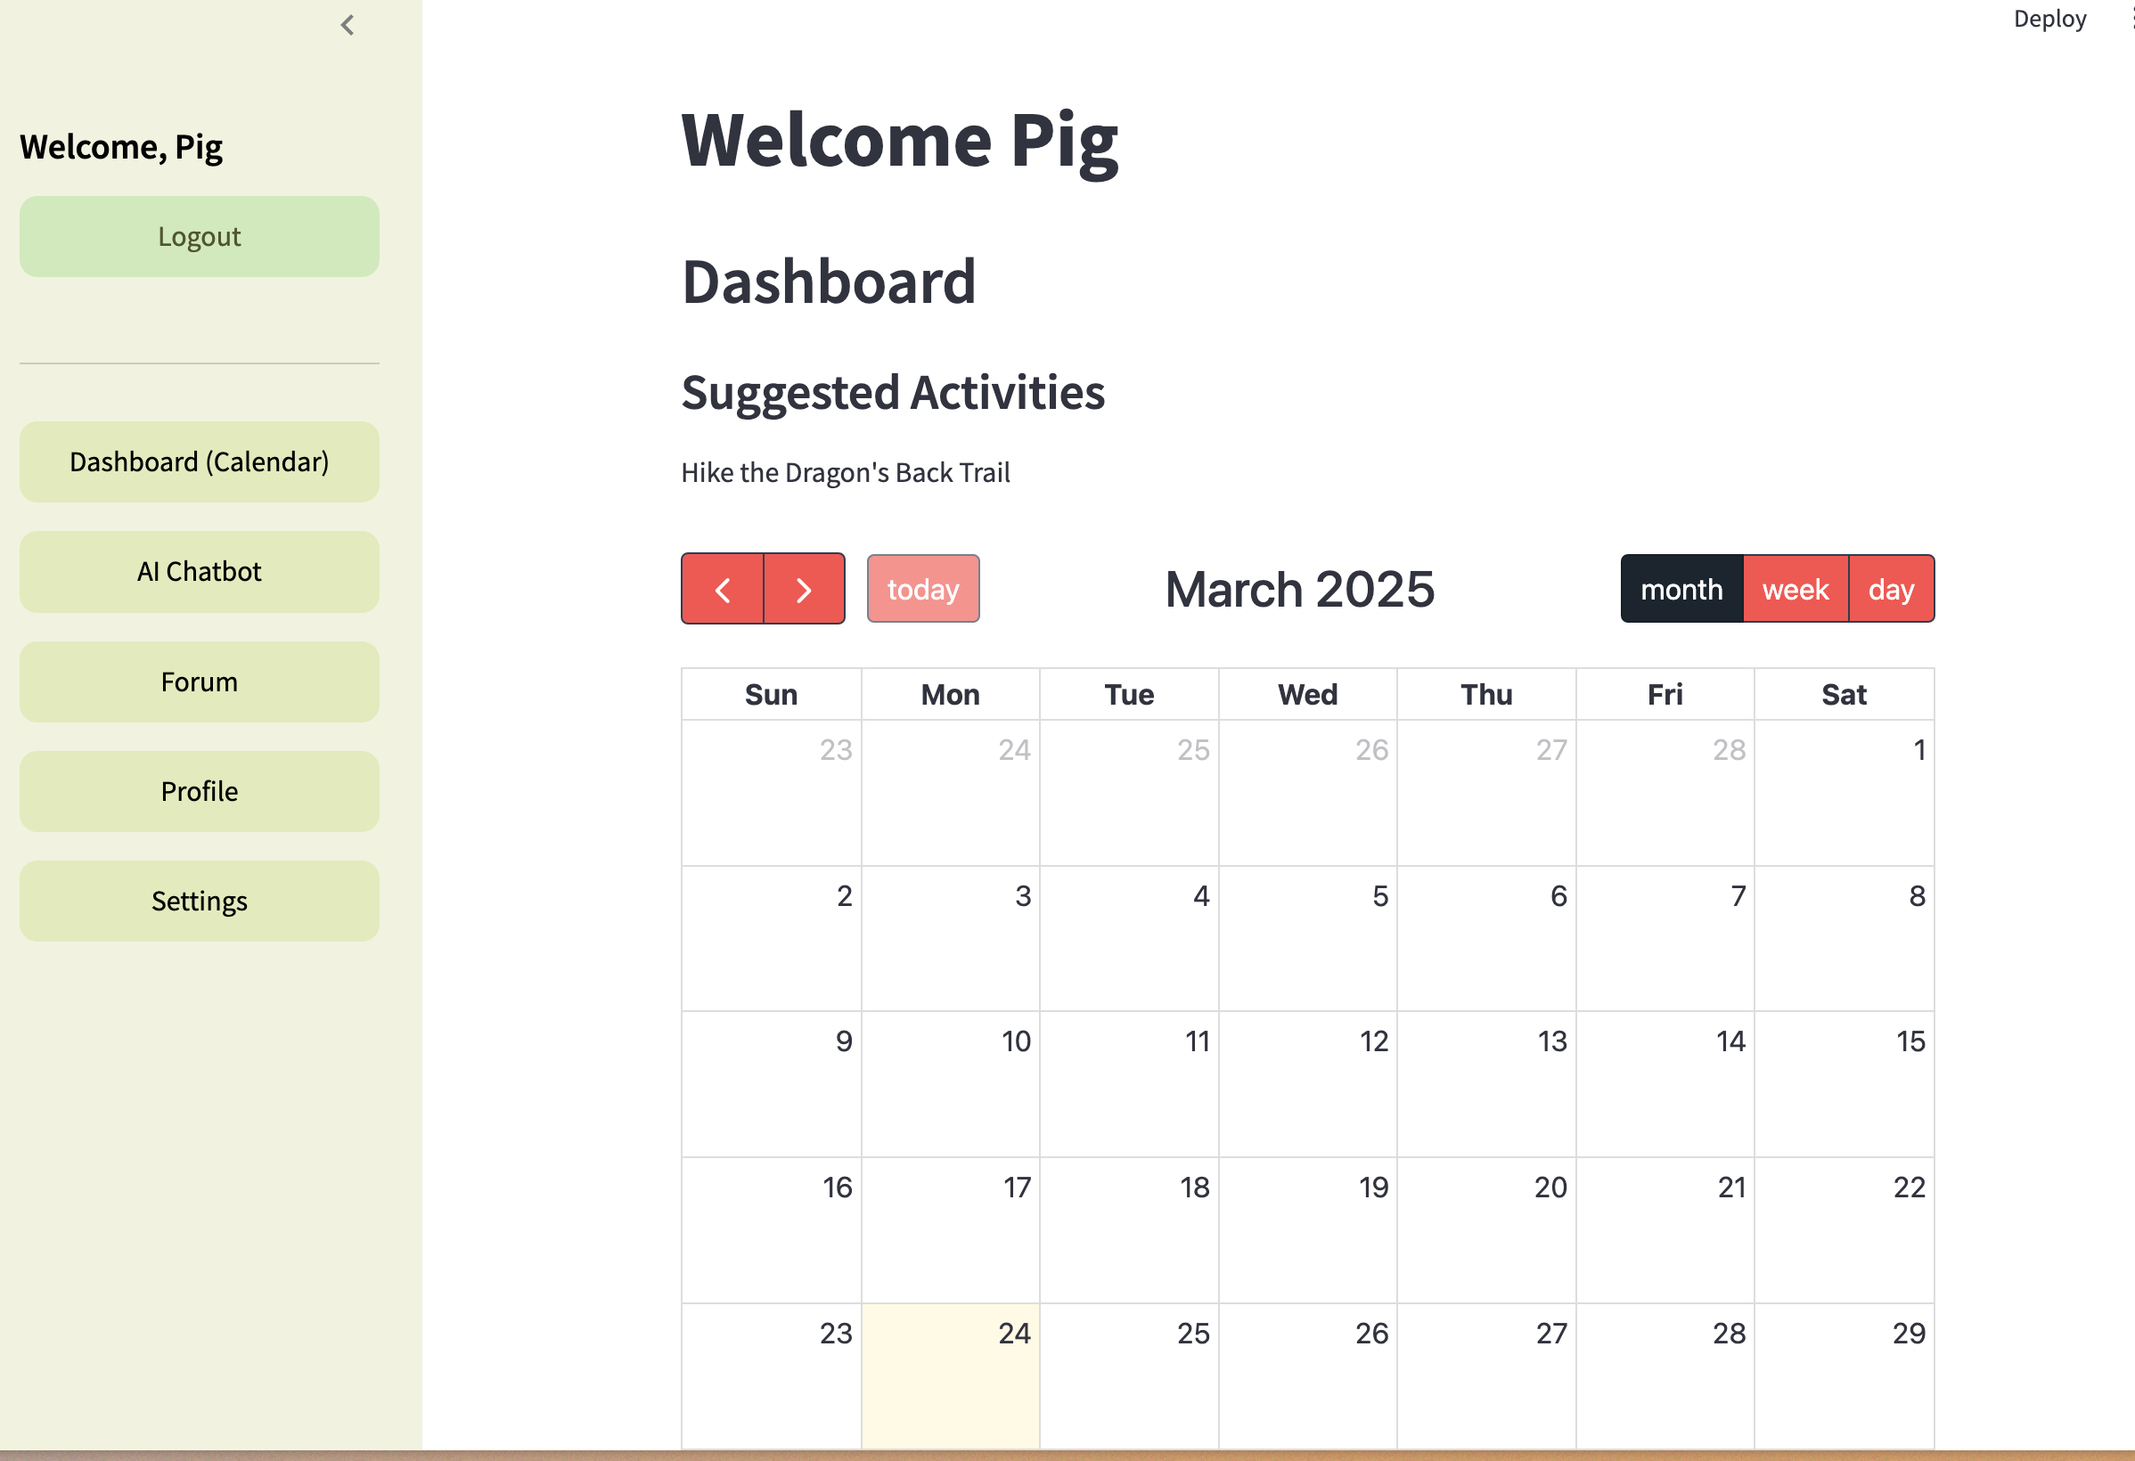
Dashboard
Personalization
Recommend activities
based on users’ interest
Calendar where user
can add events

Slide 19
Chatbot Features
Cantonese audio: As learning Cantonese is a pain point of our users, we
incorporate Cantonese audio in our Chatbot
FAQ: As users find current instructions for applying financial subsidies is
complicated, we offers a simplified step by step guide in FAQ
Cultural guidance: Slangs & Pop culture Explainer

Slide 20

Forum
During interview, they mentioned that they usually chat with new immigrant with similar age in their existing chat groups
Therefore, we design a Forum where new immigrants can mingle with new immigrants from all walks of life and post some questions

Slide 21
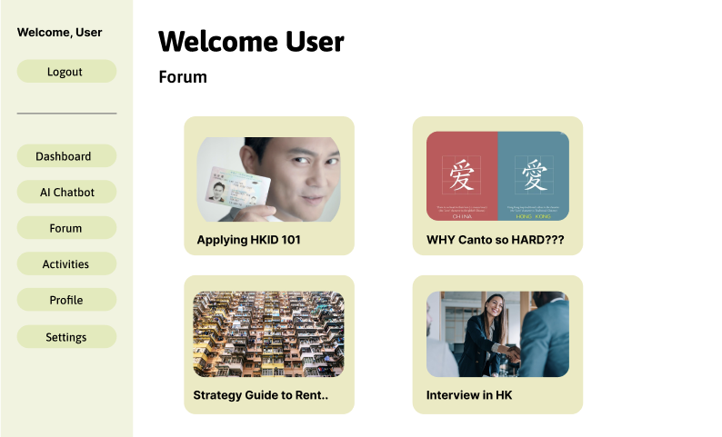
Forum Features
Create a topic
Visual representation of the topic in card view
Choose a topic you want to discuss

Slide 22
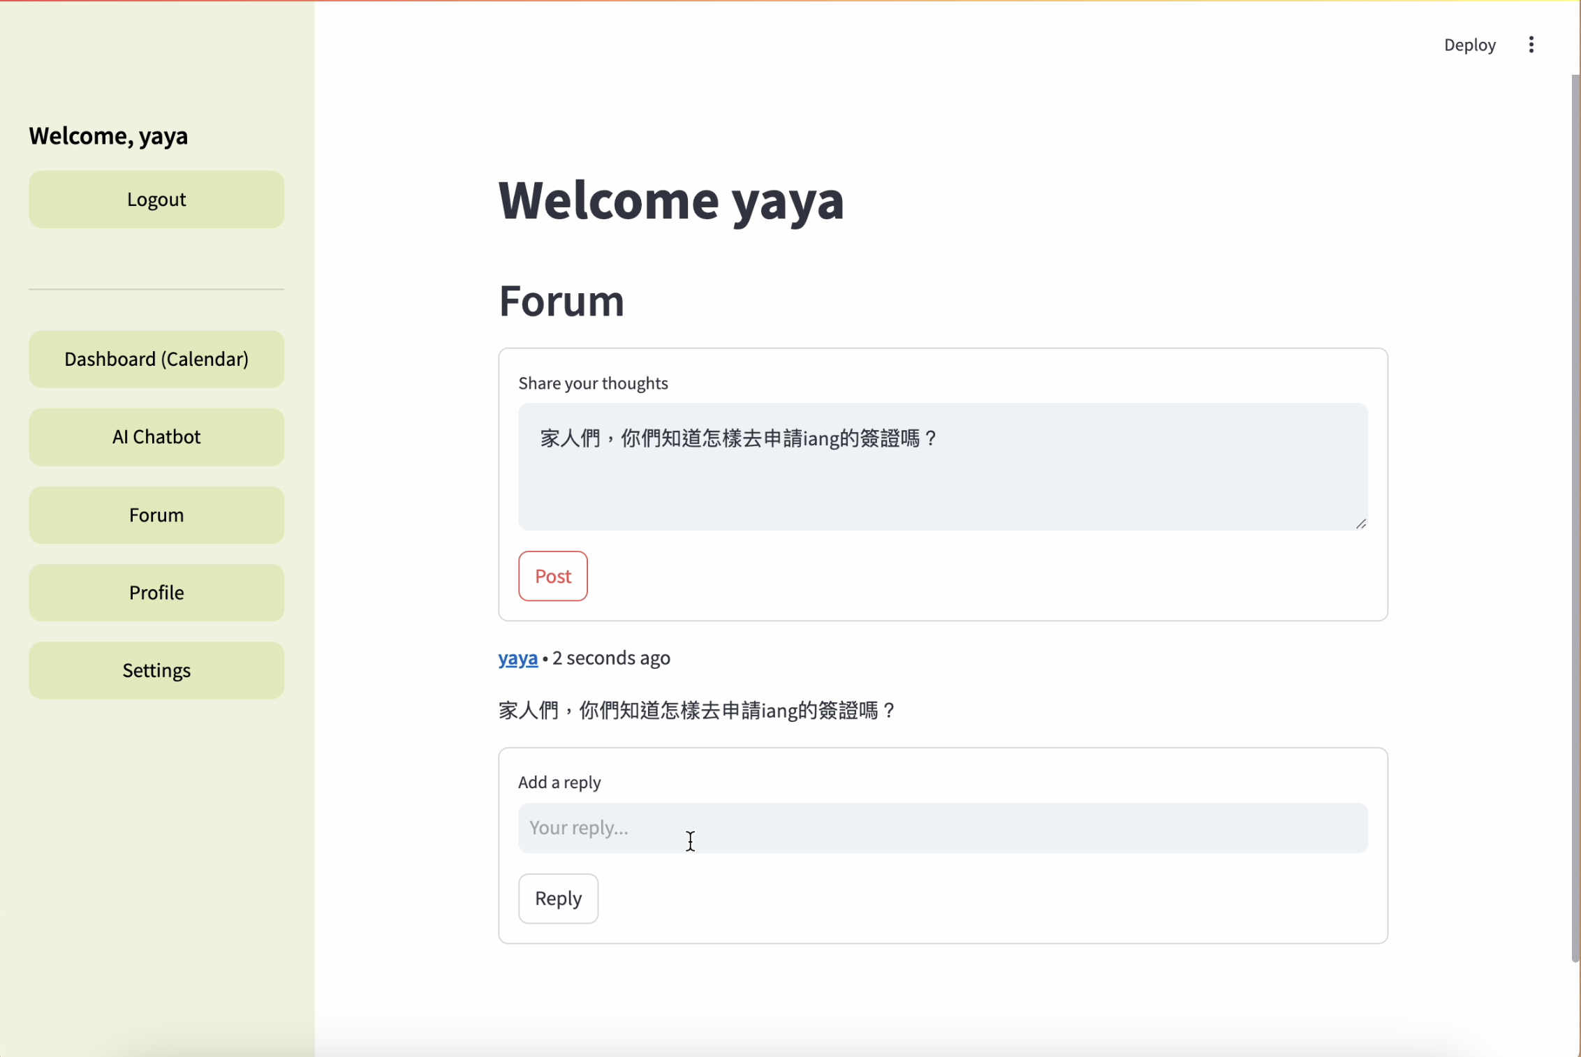
Forum Features
Post your Questions and Comments
Click onto other users’ name to connect with them

Slide 23
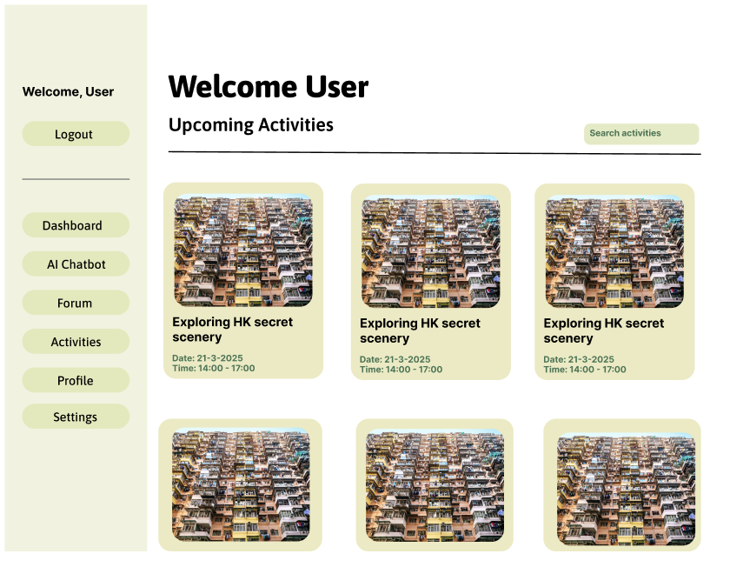
Activity Page
Show activities held
by different community
centers which targeted
to new immigrants
Offer more opportunities to explore in-depth Hong Kong with new friends

Slide 24
Play a video on Usability Test

Slide 25
04
Reflection
User feedback & Improvement

Slide 26
User feedback
Overall, it is structured with clear instructions
Invite locals to the forum to mingle with users
Add button choose to use Simplified or Traditional Chinese

Slide 27
How can we Improve?
Chatbot: we should offer choice to user so that they can
choose if they want Mandarin or Cantonese audio
WhatsApp notification if user add events in calendar
Add speech-to-text function to practice Cantonese with chatbot
Add button choose to use Simplified or Traditional Chinese
Recommend more local places / restaurants

Slide 28
THANKS!

Slide 29
ALTERNATIVE RESOURCES

